Slide 1

A Study on the Impact of Reviews on the Quality of Hospitality Education
Yeswanth Chamarthy
Saranya Chintalapati
Keerthi Bai Reddy
Siva Krishna Reddy
Swathi Banna

Slide 2

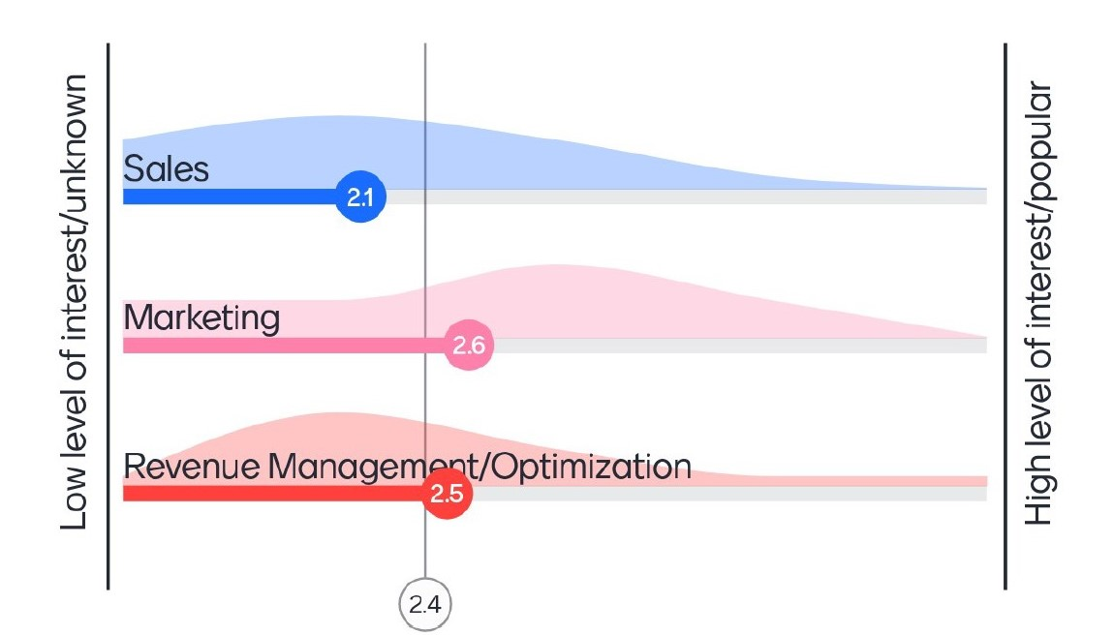

Introduction and Motivation
The pandemic greatly disrupted the hospitality industry, majorly impacting the talent pipeline, starting with hospitality schools.
The declining enrollment rate in the hospitality education sector has raised concerns about the perceived quality of education and its impact on student enrollment.
Students’ interest in various disciplines: Marketing ranks the highest, followed by Revenue Management and Sales.
Motivation: To identify the factors influencing the decline in enrollment and implement strategies to enhance the overall educational experience.

Slide 3

Business Problem
Our goal is to perform a thorough analysis to assess how reviews from current hospitality education students affect the perceived quality of the program among prospective students.

Slide 4
Data Modelling Project to address this challenge
Using Multiple Regression Models, we are predicting the impact of the below factors on future enrollments.
Ratings given to the Professors by the students.
The level of difficulty of the course, as perceived by the students.
Universities can leverage this information to enact essential adjustments aimed at boosting their enrollment figures.

Slide 5
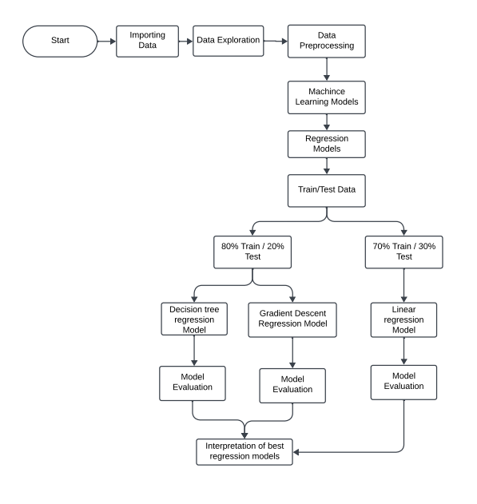
Data Flow Model

Slide 6

Dataset Description
Data Source:
https://www.ratemyprofessors.com/
Reference:
Nanu, L., Tillery, H., & Rahman, I. (2023). An Assessment of American Hospitality Programs Based on RateMyprofessor: A Big Data Approach. Journal of Hospitality & Tourism Education, 1–14. https://doi.org/10.1080/10963758.2023.2200000
‌Features:
Independent Variables: Dependent Variable:
University Name Would take again
Professor Name
Reviews
Level of difficulty
Average rating

Slide 7
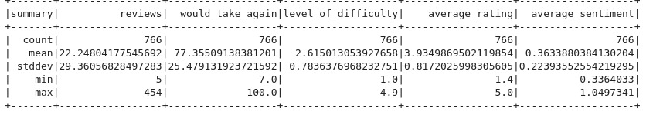
Exploratory Data Analysis
Total instances: 1210
Null Values: There are 444 null values in the Dependent Variable. These are omitted.
Data Summary:

Slide 8
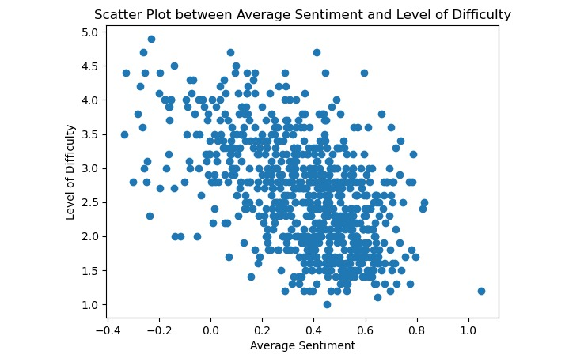
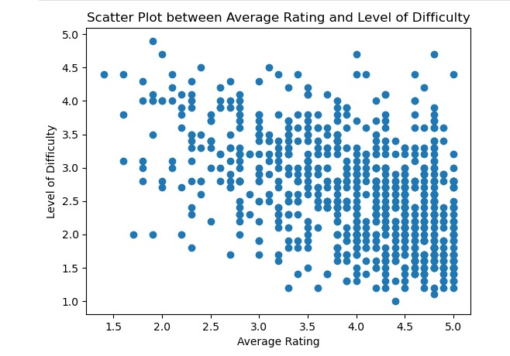
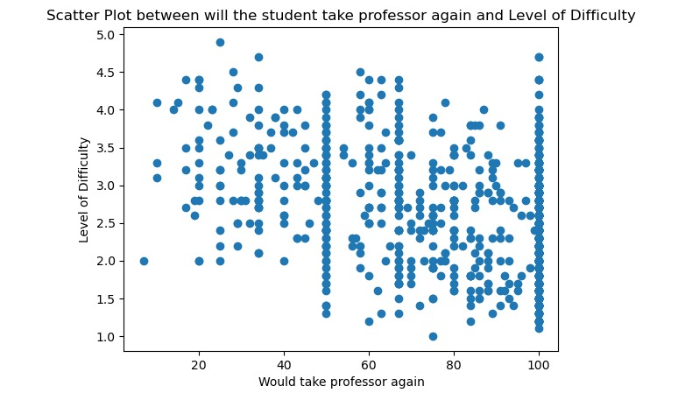
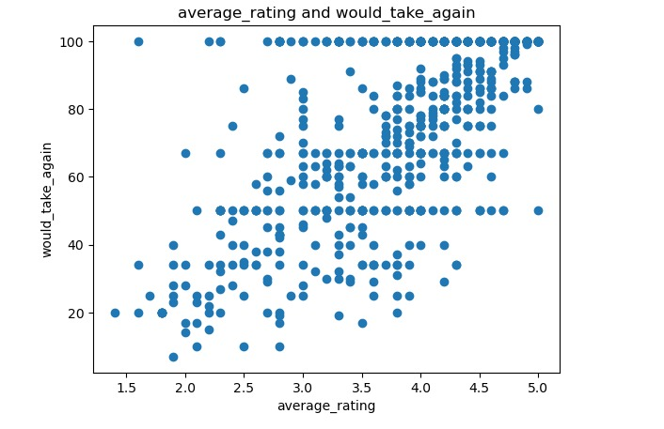
Visualizations

Slide 9
Evaluate the Solution
Model Performance Metrics:
Utilize appropriate metrics such as Mean Absolute Error (MAE), Mean Squared Error (MSE), or other relevant regression metrics, depending on the nature of the problem.
Cross-validation:
Implemented cross-validation in gradient descent to assess the model's stability and generalization performance across different subsets of the data.
Comparative Analysis:
Compare the performance of different models (linear regression, decision tree, gradient boosting) to understand their working in addressing the business problem.

Slide 10
Challenges
Enhancing Model Performance:
Model Hierarchy: Established a model hierarchy with linear regression as the initial model, followed by decision tree, and finally gradient boosting, progressively refining the model's predictive capabilities.
Iterative Tuning: Applied hyperparameter tuning techniques, especially in gradient boosting, to iteratively fine-tune the model for better performance.
In the gradient boosting, we conducted cross-validation and subsequently applied hyperparameter tuning. This resulted in a reduction in Mean Absolute Error (MAE) to 14%.
Error Handling:
To maintain the integrity of the data structure, we stored it in a database and performed analyses by fetching it.
During this process, we pinpointed areas of concern in the code, particularly focusing on mechanisms for error identification and resolution.

Slide 11
AUTHOR | CONTRIBUTION
YESWANTH CHAMARTHY | Worked on building models and enhancing model performance.
SARANYA CHINTALAPATI | Worked on data cleaning and exploration
KEERTHI BAI REDDY | Worked on model building and data cleaning
SWATHI BANNA | Worked on evaluation metrics and ppt
SIVA KRISHNA REDDY | Worked on evaluation metrics

Slide 12
Thank you

